Slide 1


DETECTION OF PHISHING WEBSITES
DEPARTMENT OF COMPUTER SCIENCE & ENGINEERING
BATCH NO-7
M.Sathiesh 166R1A0516
M.Sireesha 166R1A0517
M.Bhuvaneswari devi 166R1A0521
P.Naga bramhanandam 166R1A0528
Under the esteemed guidance of
Dr.SK. MEERA SHARIEF, Ph.D.
Associate Professor& HOD-CSE Dept.
GIET COLLEGE OF ENGINEERING
APPROVED BY AICTE , NEW DELHI | AFFILIATED TO JNTUK ,KAKINADA
Chaitanya Knowledge City , NH-16 ,Rajamahendravaram , East Godavari ,A.P

Slide 2

CONTENTS:
ABSTRACT
MODULES
ANALYSIS & PROJECT PLAN
UML DIAGRAMS
TEST CASES
OUTPUT SCREENSHOTS
CONCLUSION
REFERENCES
DETECTION OF PHISHING WEBSITES
1
24 July 2020

Slide 3
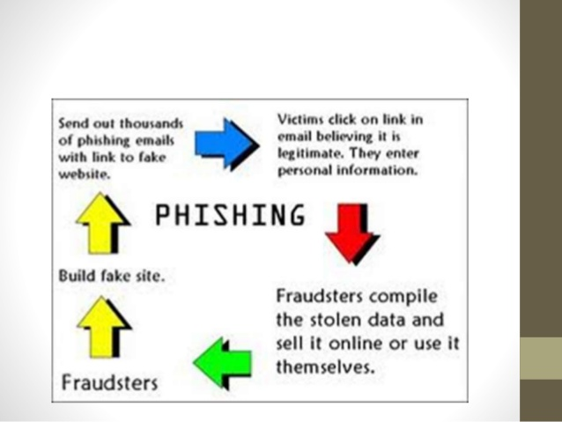
ABSTRACT:
Phishing has been a widespread issue for many years,claiming countless victims, some of which have not even realized that they fell prey.
The sole purpose of phishing is to obtain sensitive information from its victims. There have yet to be a consensus on the best way to detect phishing.
In this project, we analyze web-based phishing detection by using Random Forest. Some important URL features are identified and our study on that the detection performance
with feature selection is will be improved.
DETECTION OF PHISHING WEBSITES
2
24 July 2020

Slide 4
MODULES:
ØCreating Training dataset by selecting the features of url.
ØGenerate decision tree for url.
ØGenerate test data set.
Analyze Result.
DETECTION OF PHISHING WEBSITES
3
24 July 2020

Slide 5
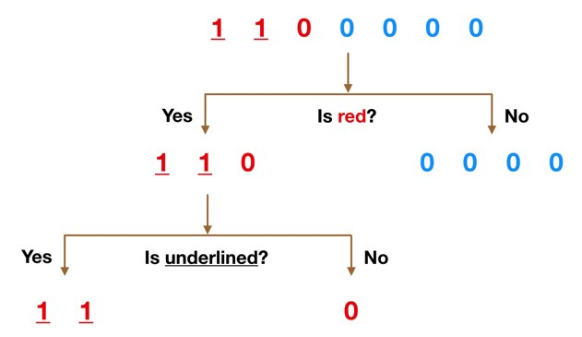
Create Training dataset:
Training data is also known as a training set, training dataset or learning set.
The training data is an initial set of data used to help a program understand how to apply technologies like neural networks to learn and produce sophisticated results.
Generate decision tree:
Decision trees as they are the building blocks of the random forest model.
Imagine that our dataset consists of the numbers at the side of figure to the left. We have two 1s and five 0s.
DETECTION OF PHISHING WEBSITES
4
24 July 2020

Slide 6
Generate test data set:
A test dataset is a dataset that is independent of the training dataset, but that follows the same probability distribution as the training dataset. If a model fit to the training dataset also fits the test dataset well, minimal over fitting has taken place.
Analyze result:
Analyze the results after completion of test dataset processing wheather it was benign or not.
DETECTION OF PHISHING WEBSITES
5
24 July 2020

Slide 7
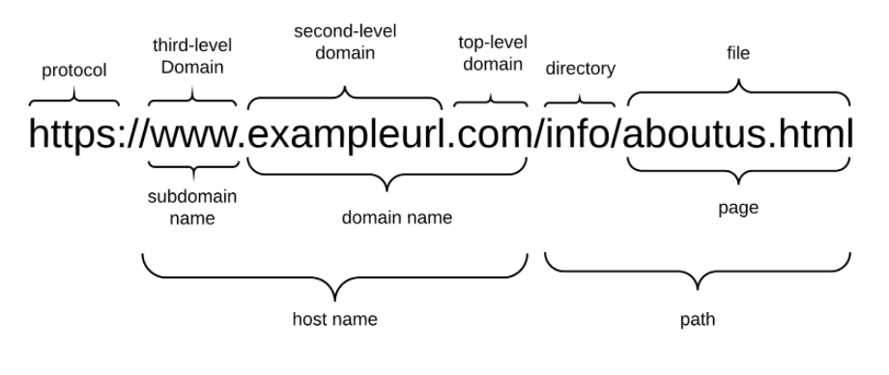
Features of URL:
A phishing URL and the corresponding page have several features which can be differentiated from a malicious URL.
URL-Based Features
Domain-Based Features
Page-Based Features
Content-Based Features
DETECTION OF PHISHING WEBSITES
6
24 July 2020

Slide 8
1.Having an internet protocol (IP) Address
If the IP address is used as the domain of the URL, such as http://125.98.2.142/conto@h.html,
it can be suspected that attempts to steal information. The IP address can also be converted into hexadecimal code.
Rule: IF{ If The Domain Part has an IP Address → Phishing
2.URL Length
Long URLs can also be suspected of being a phishing site like this one:
http://mencobasitus.com.nr/4c/rea/4b53e4i6f913e51234hfyg46f363r734/?cmd=_home&dispatch=1212325vdvtyvwtew5wtetuyuijba5672uh2bi2822gy267gehh74y7@phishing. website.html. If the URL length greater than or equal to 54 characters then the URL included as a phishing site.
3.Having @ Symbol
URLs using the symbol @ will lead to the browser to ignore everything that precedes the @ symbol.
Rule: IF{ Url Having @ Symbol → Phishing
DETECTION OF PHISHING WEBSITES
7
24 July 2020

Slide 9
4.Double Slash Redirecting
Double slash or "//" indicates that the user or the user will be redirected to another site. The
position of the use of double slash usually appears at the sixth position as written at this link
http://amikom.ac.id. However, if the double slash appears in the seventh position as https://amikom.ac.id it can be suspected as a phishing site.
Rules: IF{ The Position of the Last Occurrence of “//”in the url>7 (phishing)
Otherwise(legitimate)
5.Protocol
HTTPS Token In general, the https token can be added by phisher on the domain URL and has the objective to distract the user like at http://https-www-amikom-coolest-college.com.
Rules: IF{ Using HTTP Token in Domain Part of The URL → Phishing
Otherwise → Legitimate
6.Having Sub Domains
Rules: IF
Rule : if{ Dots In Domain Part = 1 → Legitimate Dots
In Domain Part = 2 → Suspicious
otherwise : phishing
DETECTION OF PHISHING WEBSITES
8
24 July 2020

Slide 10
7.Submitting to Email
The official website will generally send personal information to the server for processing.
While the phisher will be sending the information to his personal email, it can be suspected by
the use of scripts on the server side functions such as "mail ()" and on the client side will use the mailto.
Rules: IF{ Using "mail()" or "mailto:" Function to Submit User Information → Phishing
otherwise → legitimate
8.Abnormal URL
On the website is legitimate, then the identity of the website will be contained in the URL.
Rules: IF{ The Host Name Is Not Included In URL → Phishing
Otherwise → Legitimate
DETECTION OF PHISHING WEBSITES
9
24 July 2020

Slide 11
ANALYSIS:
Problem Definition:
Nowadays Phishing becomes a main area of concern for security, Phishing is a cyber-attack which targets naive online users tricking into revealing sensitive information such as username, password, social security number or credit card number etc.
Proposed Solution:
Our project focuses on web-based phishing detection and aims to identify the most
relevant subset of features that can accurately identify phishing URLs, using the
Random Forests classiﬁer.
Objective:
The main objective of the project is to detect the phishing websites by using machine learning RFA algorithm with less executable time and without false positives.
DETECTION OF PHISHING WEBSITES
10
24 July 2020

Slide 12
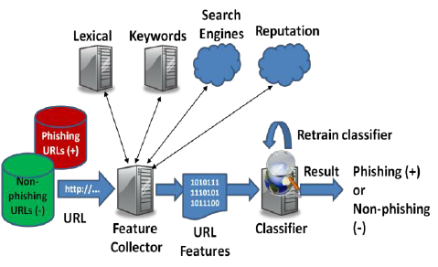
PROJECT PLAN:
DETECTION OF PHISHING WEBSITES
11
24 July 2020

Slide 13
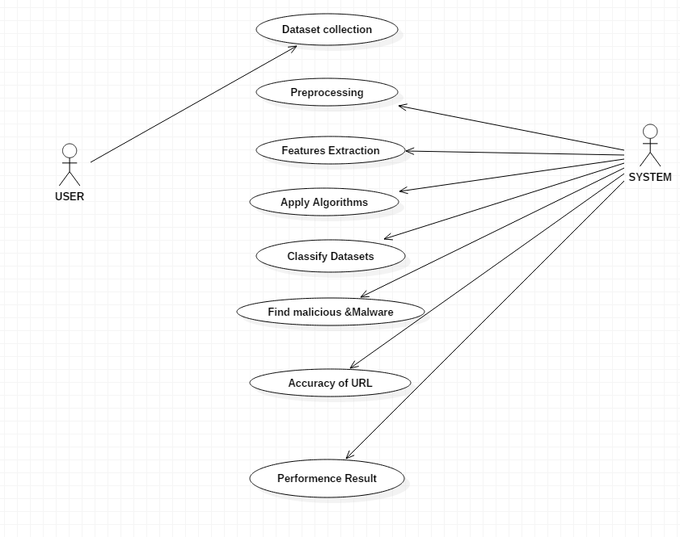
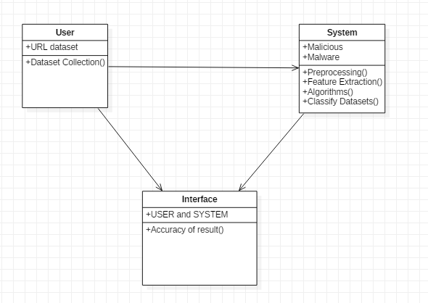
UML DIAGRAMS: USECASE DIAGRAM: CLASS DIAGRAM:
DETECTION OF PHISHING WEBSITES
12
24 July 2020

Slide 14

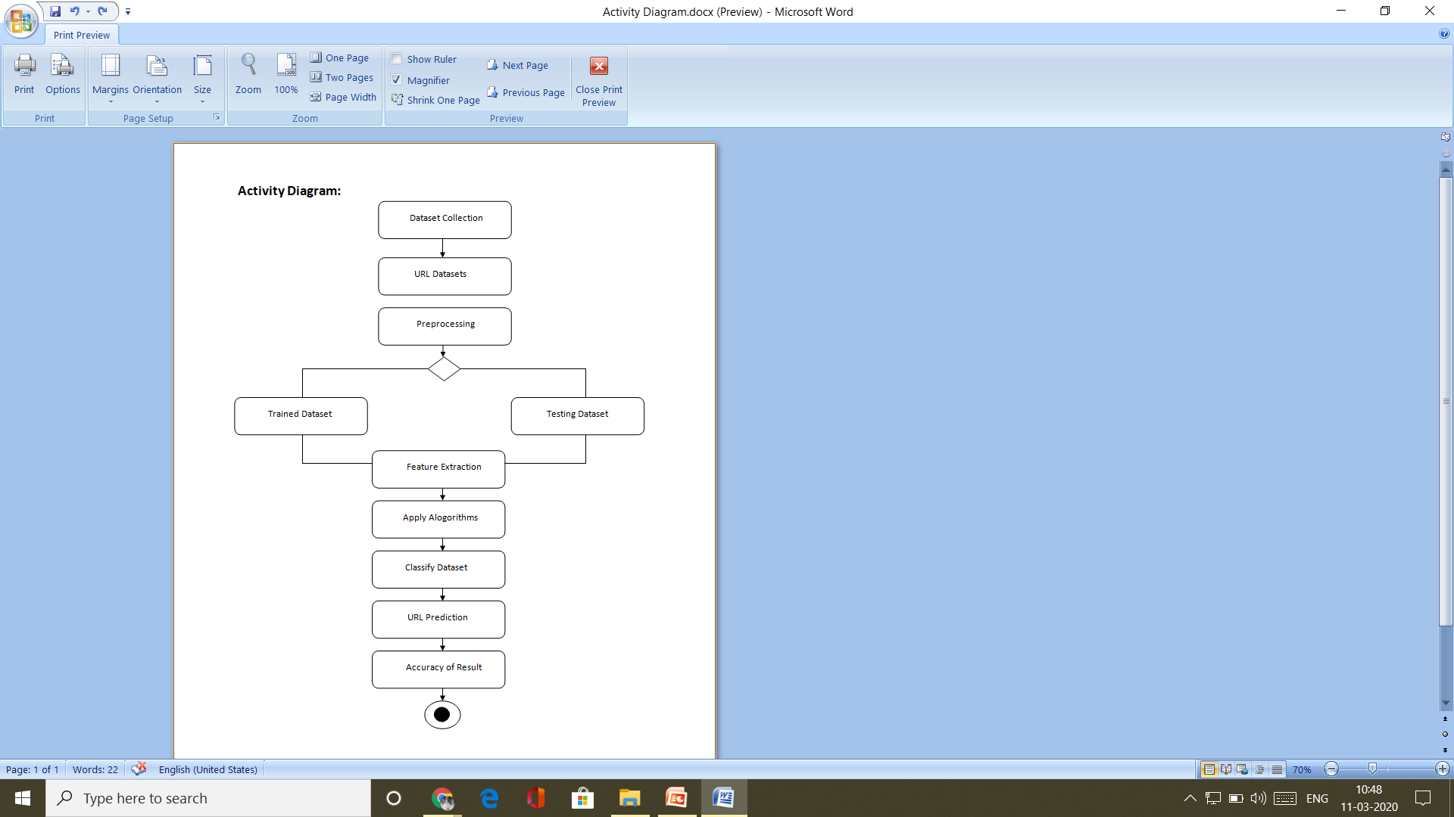
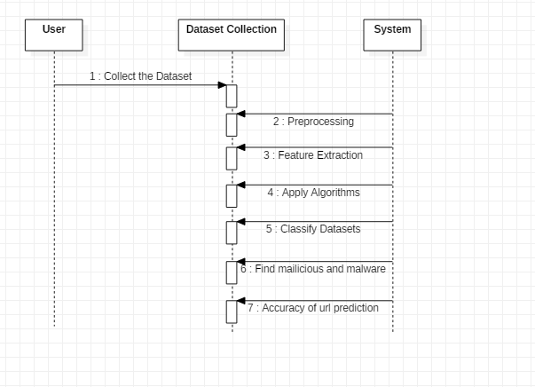
ACTIVITY DIAGRAM: SEQUENCE DIAGRAM: :
DETECTION OF PHISHING WEBSITES
13
24 July 2020

Slide 15
TEST CASES:
Test cases | Input | Description | Expected Result | Pass/Fail
TC1 | URL contains mail or mailto() | If phisher uses the mail or mailto() in url | -1 (url is phished) | Pass
TC2 | URL Consists of https protocol | URL contain secure socket layer | 1 (url is benign) | Pass
TC3 | URL length Greater than 54 | URL contain length greater than 54 | -1 (url is suspicious) | Pass
TC4 | Entered URL is empty | If your input URL is null | Invalid URL | Fail
TC5 | URL has @ symbol | If URL contain @ symbol it will skips the other part of the url | -1 (url is phished) | Pass
TC6 | URL don’t have domain name | If URL doesn’t contain domain name | -1 (url is phished) | Pass
TC7 | URL contain http in domain name | If http exists in domain name | -1 (url is phished) | Pass
TC8 | If “//” position violates in URL | Occurance position of “//” greaterthan 7 in URL | -1 (url is phished) | Pass
TC9 | URL has more dots | If url contains more than three dots | -1 (url is phished) | Pass
TC10 | URL consists IP address in domain name | URL contain domain name with only numeric values | -1 (url is phished) | Pass
DETECTION OF PHISHING WEBSITES
14
24 July 2020

Slide 16
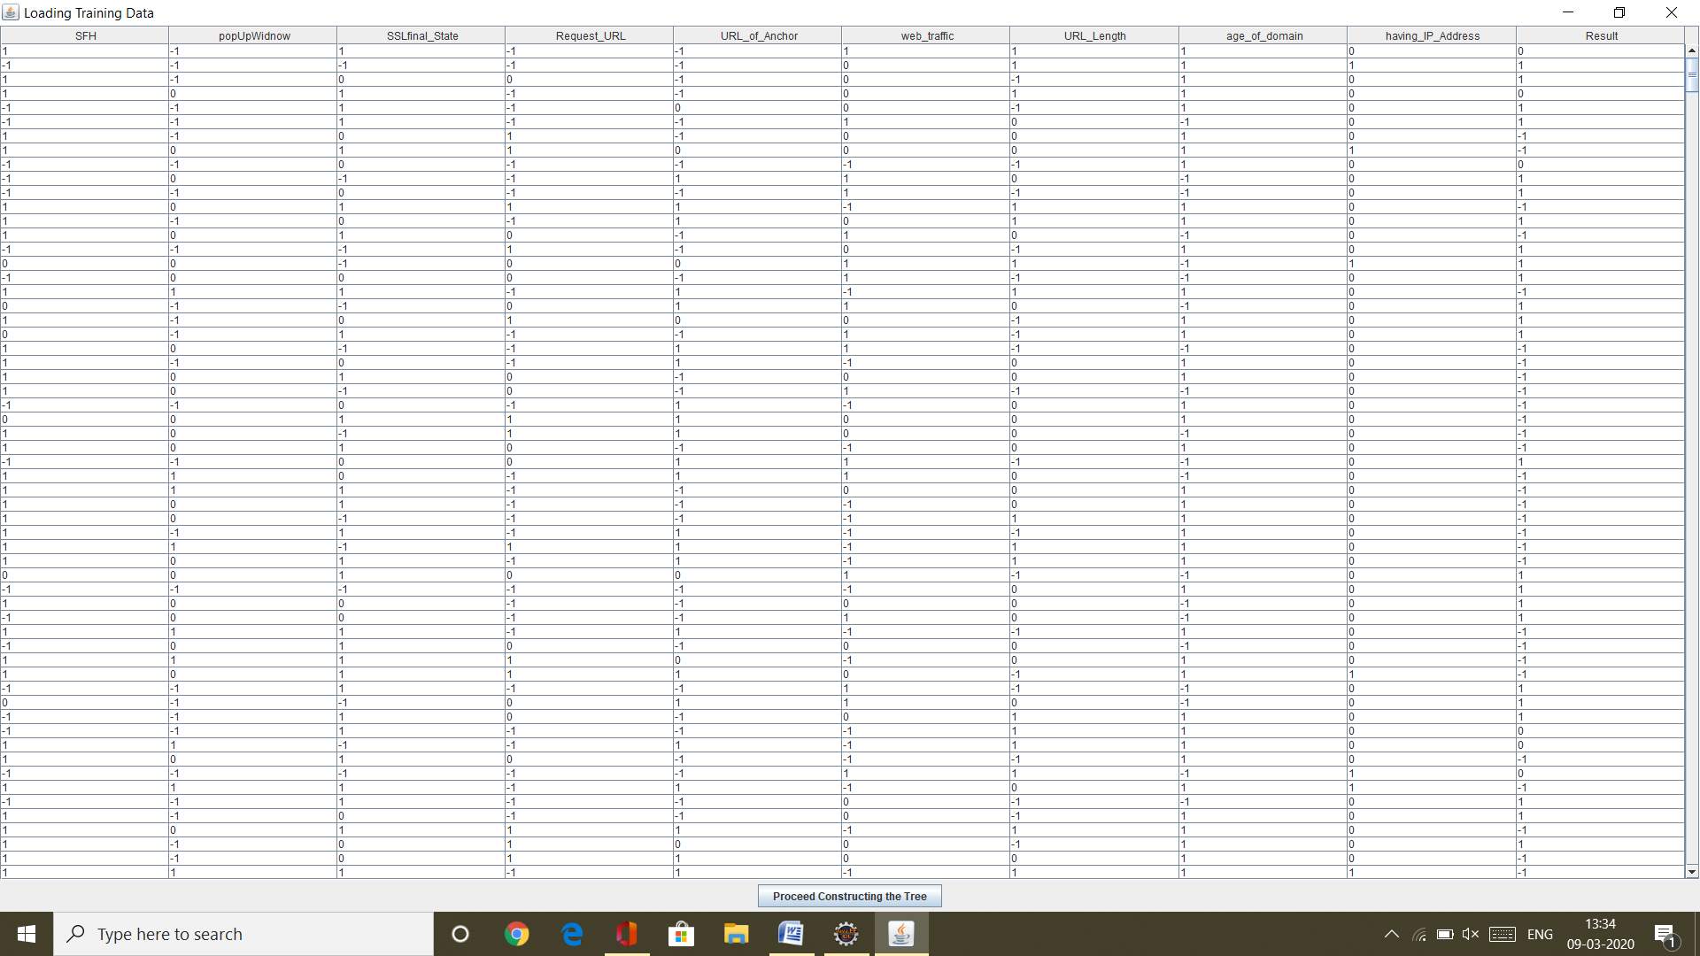
OUTPUT SCREENSHOTS: Loading Training dataset
Training dataset
DETECTION OF PHISHING WEBSITES
15
24 July 2020

Slide 17
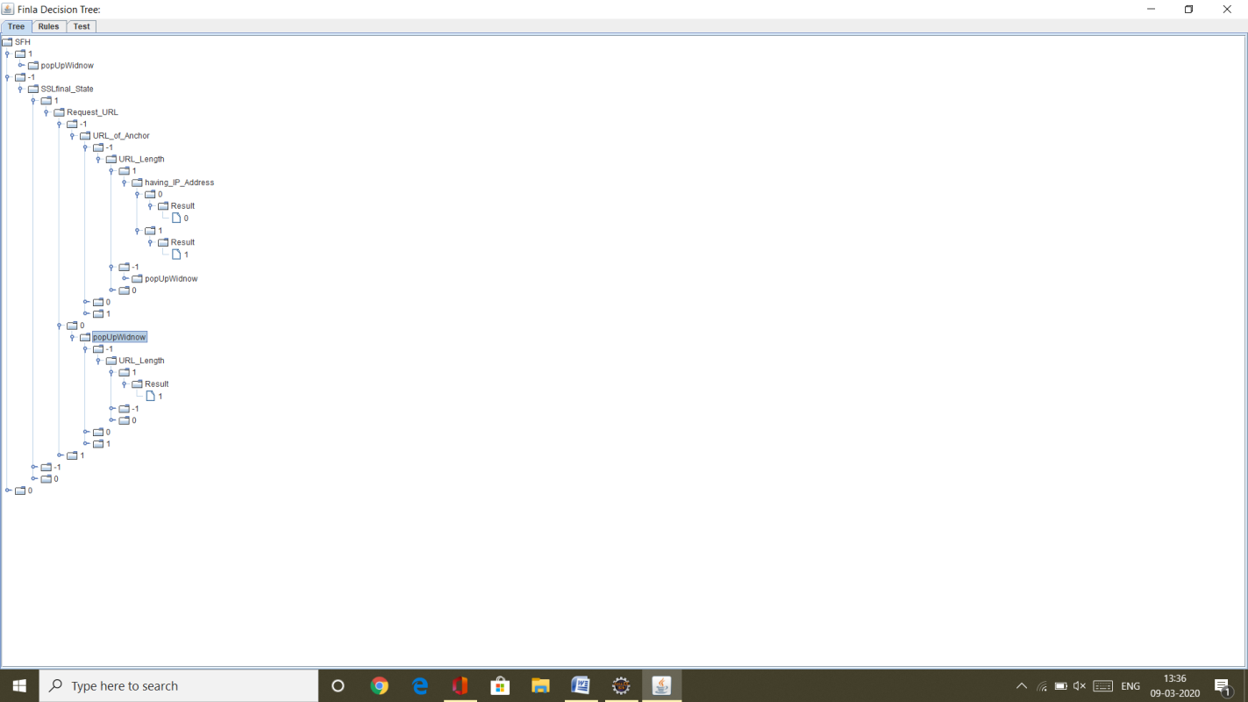
Construction Of Decision Trees:
Construction Of Decision Tree
DETECTION OF PHISHING WEBSITES
16
24 July 2020

Slide 18
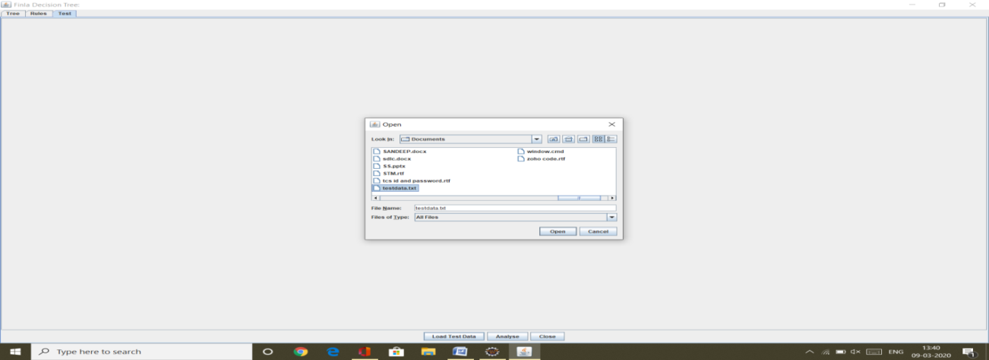
Loading Test Dataset:
Test Dataset
DETECTION OF PHISHING WEBSITES
17
24 July 2020

Slide 19
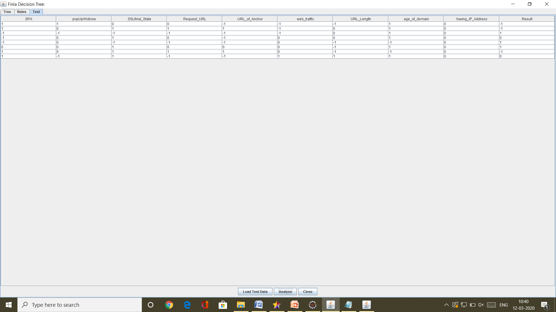
Analysing Results:
Analyse results
DETECTION OF PHISHING WEBSITES
18
24 July 2020

Slide 20
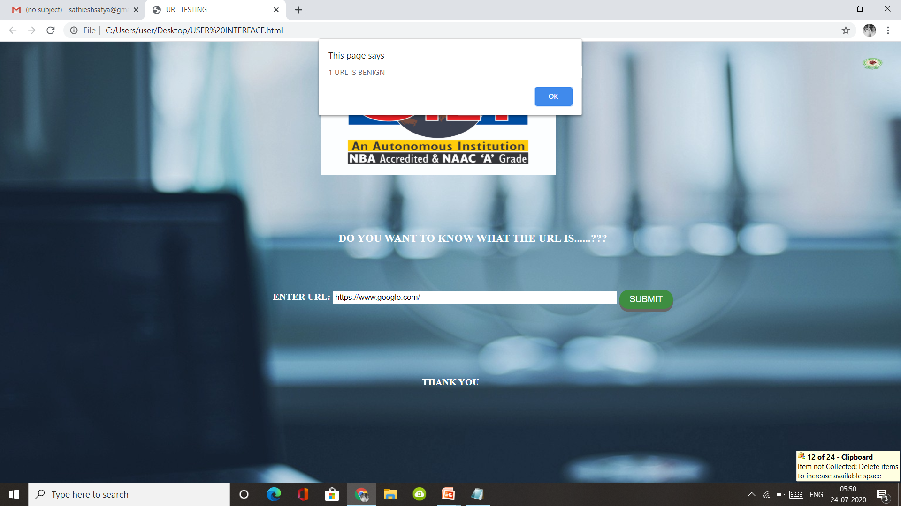
Analyzing results from User interface for benign url
DETECTION OF PHISHING WEBSITES
19
24 July 2020

Slide 21
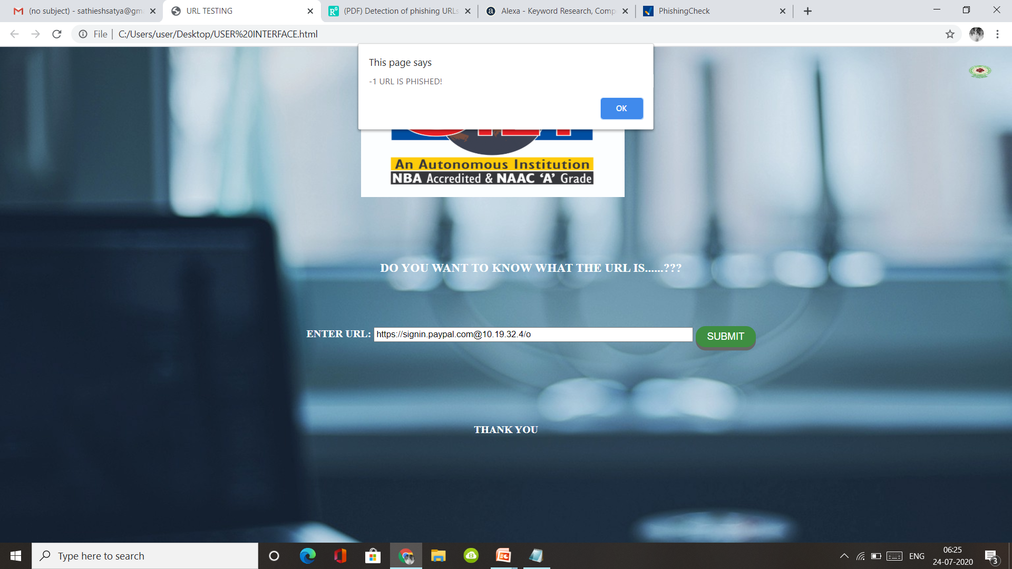
Analyzing results from User interface for phishing url
DETECTION OF PHISHING WEBSITES
20
24 July 2020

Slide 22
CONCLUSION :
Phishing is a form of criminal conduct that poses increasing threats to consumers, financial institutions, and commercial enterprises in Canada, the United States, and other countries. Because phishing shows no sign of abating, and indeed is likely to continue in newer and more sophisticated forms, law enforcement, other government agencies, and the private sector in both countries will need to cooperate more closely than ever in their efforts to combat phishing, through improved public education, prevention, authentication, and binational and national enforcement efforts.​
DETECTION OF PHISHING WEBSITES
21
24 July 2020

Slide 23
REFERENCES:
[1].Anti-PhishingWorkingGroup(APWG).APWG Homepage.http://www.antiphishing.org/,2007.
[2]. Blake Ross, Collin Jackson, Nicholas Miyake, Dan Boneh, and John C.Mitchell.Stronger Password Authentication Using Browser Extensions.In 14th Usenix Security Symposium, 2005.
[3]. Engin Kirda and Christopher Kruegel. Protecting Users against Phishing AttacksThe Computer Journal, 2006.
[4]. Fritz Schneider, Niels Provos, Raphael Moll, Monica Chew, and Brian Rakowski. Phishing Protection Design Documentation. http://wiki.mozilla.org/Phishing Protection: Design Documentation, 2007.
[5]. J. Ma, L. Saul, S. Savage, and G. Voel, Beyond blacklists: Learning to detect malicious web sites from suspicious urls, In The 15th ACM SIGKDD ker Conference On Knowledge Discovery and Date Mining, 2009.
DETECTION OF PHISHING WEBSITES
22
24 July 2020

Slide 24
Any Queries
??
DETECTION OF PHISHING WEBSITES
23
24 July 2020

Slide 25
THANK YOU
DETECTION OF PHISHING WEBSITES
24
24 July 2020

